Slide 1

Comprehensive Data Science Project: Economic Impact Analysis
This project showcases a complete data science workflow, from raw data to actionable insights. We integrate diverse datasets and advanced techniques to analyze economic impacts on key industries, culminating in an interactive dashboard for strategic decision-making.

Slide 2

Introduction: Analyzing Economic Factors on Sales
Our core objective is to rigorously analyze how broader economic factors influence automobile and real estate sales. This involves meticulous data extraction, sophisticated visualization techniques, and robust regression modeling to uncover hidden relationships.
The insights derived are critical for strategic business decisions, enabling stakeholders to anticipate market shifts and adapt their strategies proactively. Understanding these trends provides a competitive edge in volatile economic climates.

Slide 3



Data Collection & Wrangling Strategies
Diverse Data Sources
Pre-processing Techniques
Ensuring Data Integrity
Automobile sales, GDP and recession indicators, and a comprehensive Kaggle real estate dataset formed our analytical foundation.
We applied rigorous wrangling: dropping irrelevant columns, handling missing values (NaNs), merging disparate datasets, and precise data type conversions.
These steps were crucial for ensuring data quality, consistency, and readiness for subsequent exploratory analysis and model training.

Slide 4
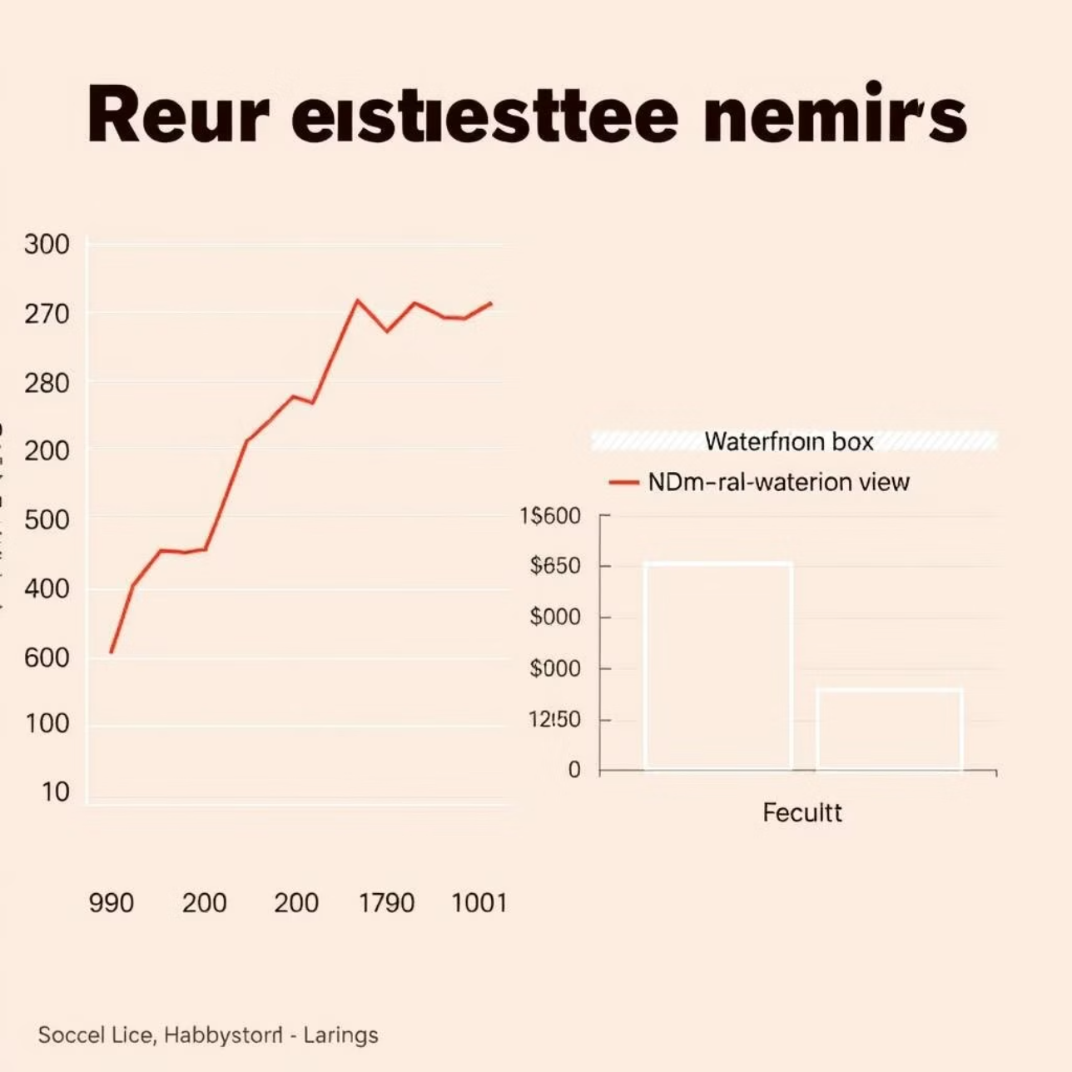
Exploratory Data Analysis & Visual Analytics (I)
Using Seaborn and Matplotlib, we generated line plots to clearly illustrate the pronounced drop in sales across both sectors during the 2008-2009 recession, highlighting the sensitivity of these markets to economic downturns.
Boxplots provided visual insights into price distributions and identified outliers, particularly contrasting properties with and without a waterfront view, revealing significant value premiums.

Slide 5
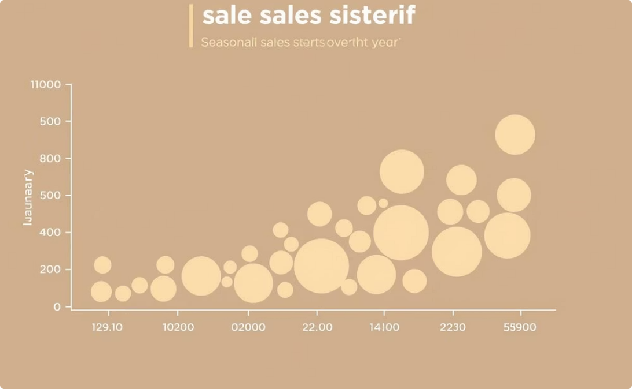
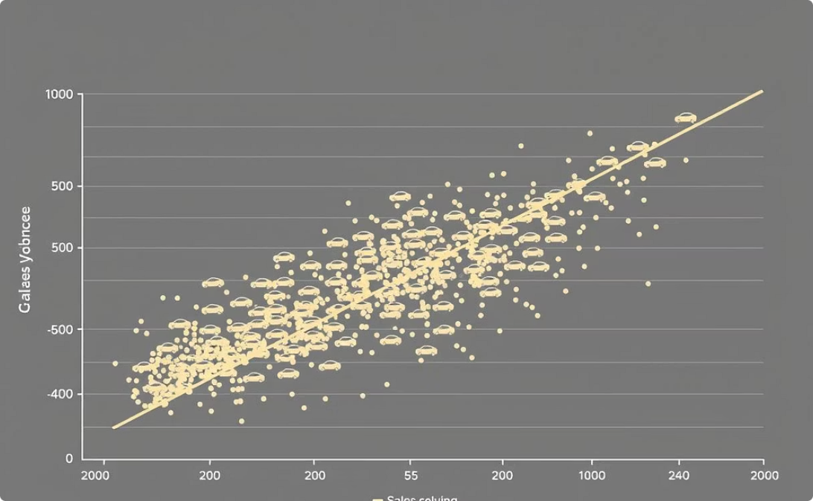
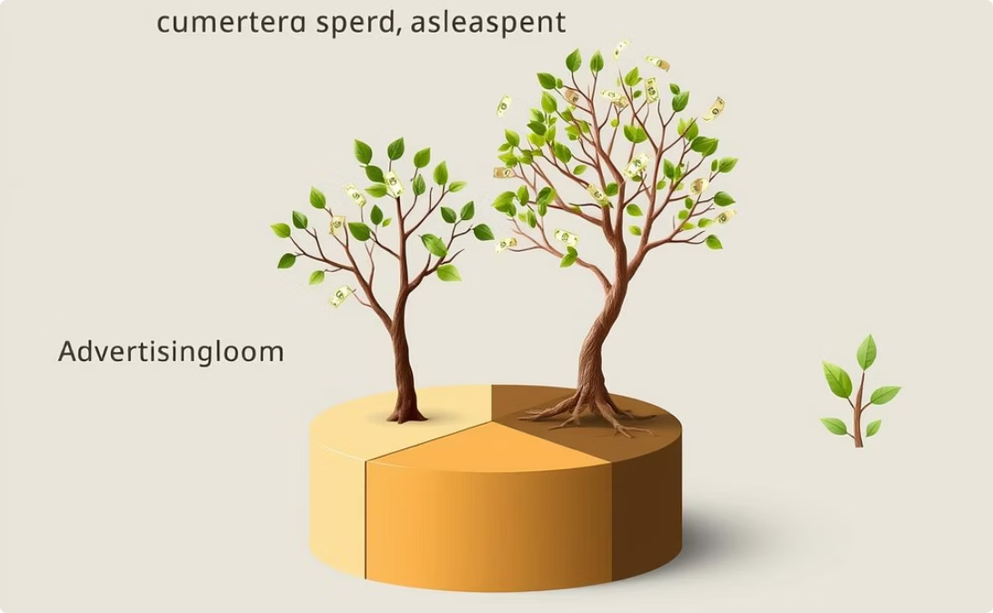
Exploratory Data Analysis & Visual Analytics (II)
Seasonality in Sales
Price-Volume Correlation
Ad Spend Analysis
Bubble plots visually confirmed recurring seasonal patterns in sales volumes, essential for inventory management.
Scatter plots revealed the correlation between vehicle pricing and sales volume, informing pricing strategies.
Pie charts disaggregated advertising expenditure across varying economic conditions, optimizing marketing budgets.

Slide 6
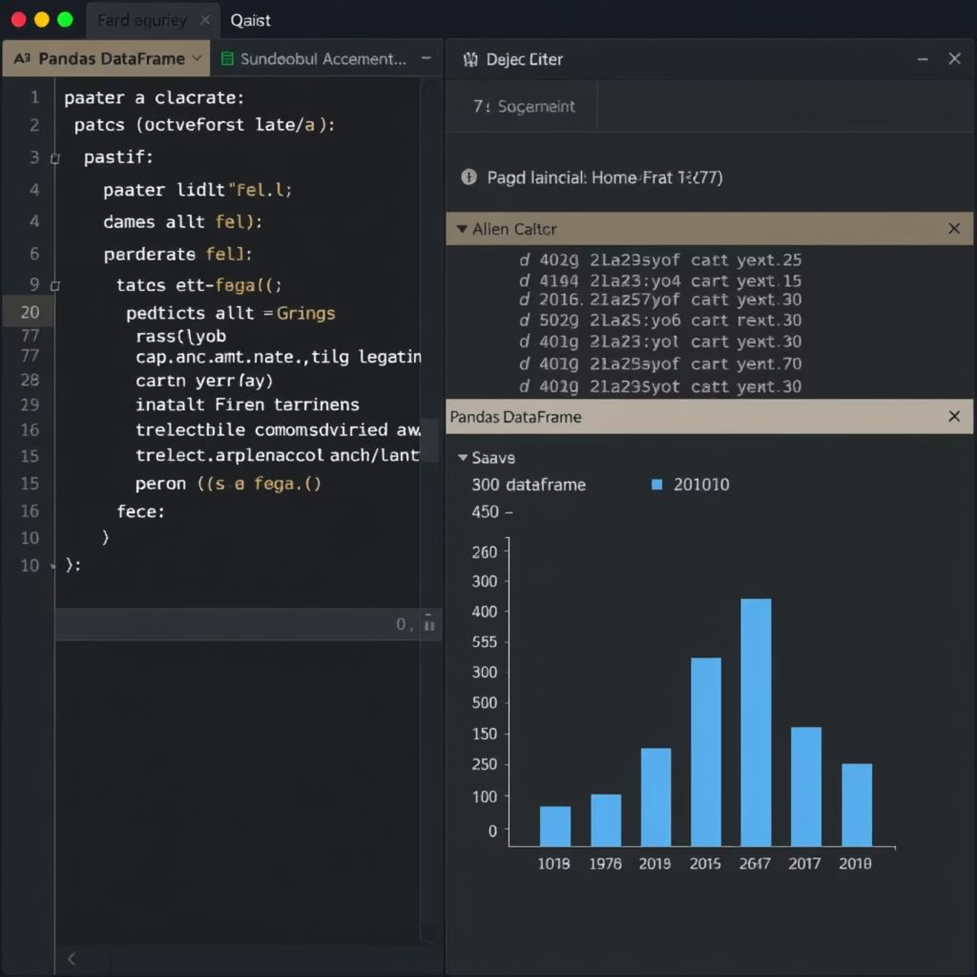
In-Depth EDA with SQL Querying
Leveraging SQLite3, we connected to the relational database to perform targeted SQL queries, enriching our exploratory data analysis. This allowed for granular investigation of complex relationships within the datasets.
Key queries included: calculating average prices by geographic location, identifying the most prevalent house types, and aggregating sales data grouped by year and specific regions to observe temporal and spatial trends. The structured outputs from these SQL queries were then seamlessly integrated with Pandas for further manipulation and visual presentation.

Slide 7
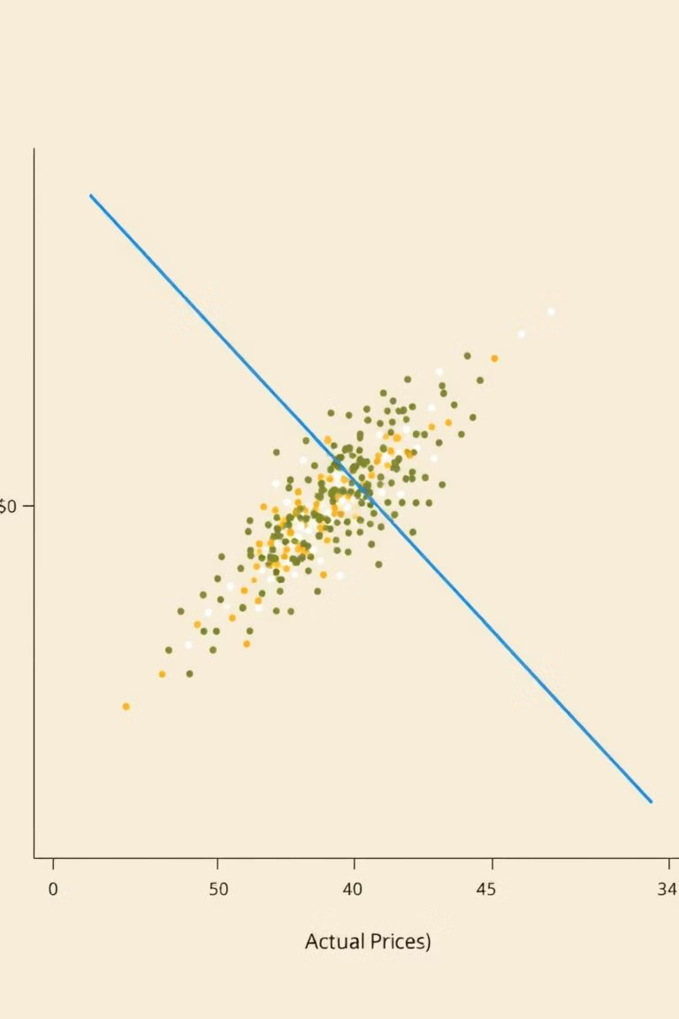
Predictive Analysis: Linear Regression
Model Implementation
Selected Predictors
Utilized `sklearn.linear_model.LinearRegression` to predict real estate prices, leveraging key housing features.
Key independent variables included `sqft_living`, `grade`, and `view`, identified as significant determinants of price.
Performance & Visualization
Achieved an R-squared score of approximately 0.76, indicating a strong fit. Prediction results were visualized for clarity.

Slide 8
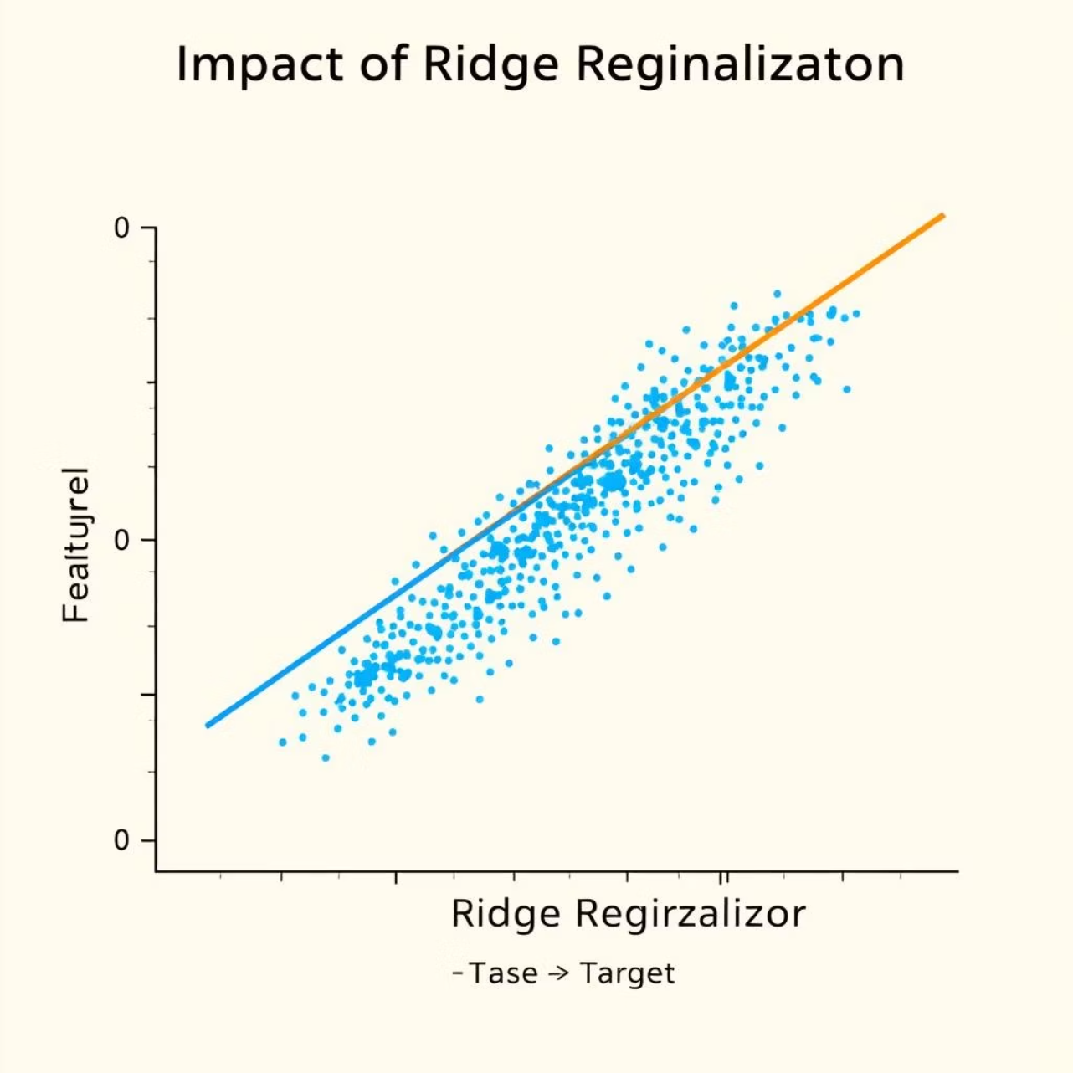
Predictive Analysis: Ridge Regression
To mitigate potential overfitting and enhance model robustness, we implemented Ridge Regression from `sklearn.linear_model`. An alpha value of 0.1 was carefully selected after cross-validation to balance bias and variance.
Ridge Regression applies L2 regularization, penalizing large coefficients and thus reducing their impact. This led to an R-squared score of approximately 0.71 on the test data, demonstrating improved generalization compared to standard linear regression, especially in the presence of multicollinearity.

Slide 9






Interactive Geospatial Analysis with Folium
Sales Impact Coloring
Regions were color-coded based on the magnitude of sales impact, providing immediate visual cues on economic vulnerability.
Choropleth Map
Developed an interactive Choropleth map using Folium to visualize office locations during recessionary periods.
Regional Variance
This map effectively highlights significant regional variances in economic recovery and resilience post-recession.

Slide 10
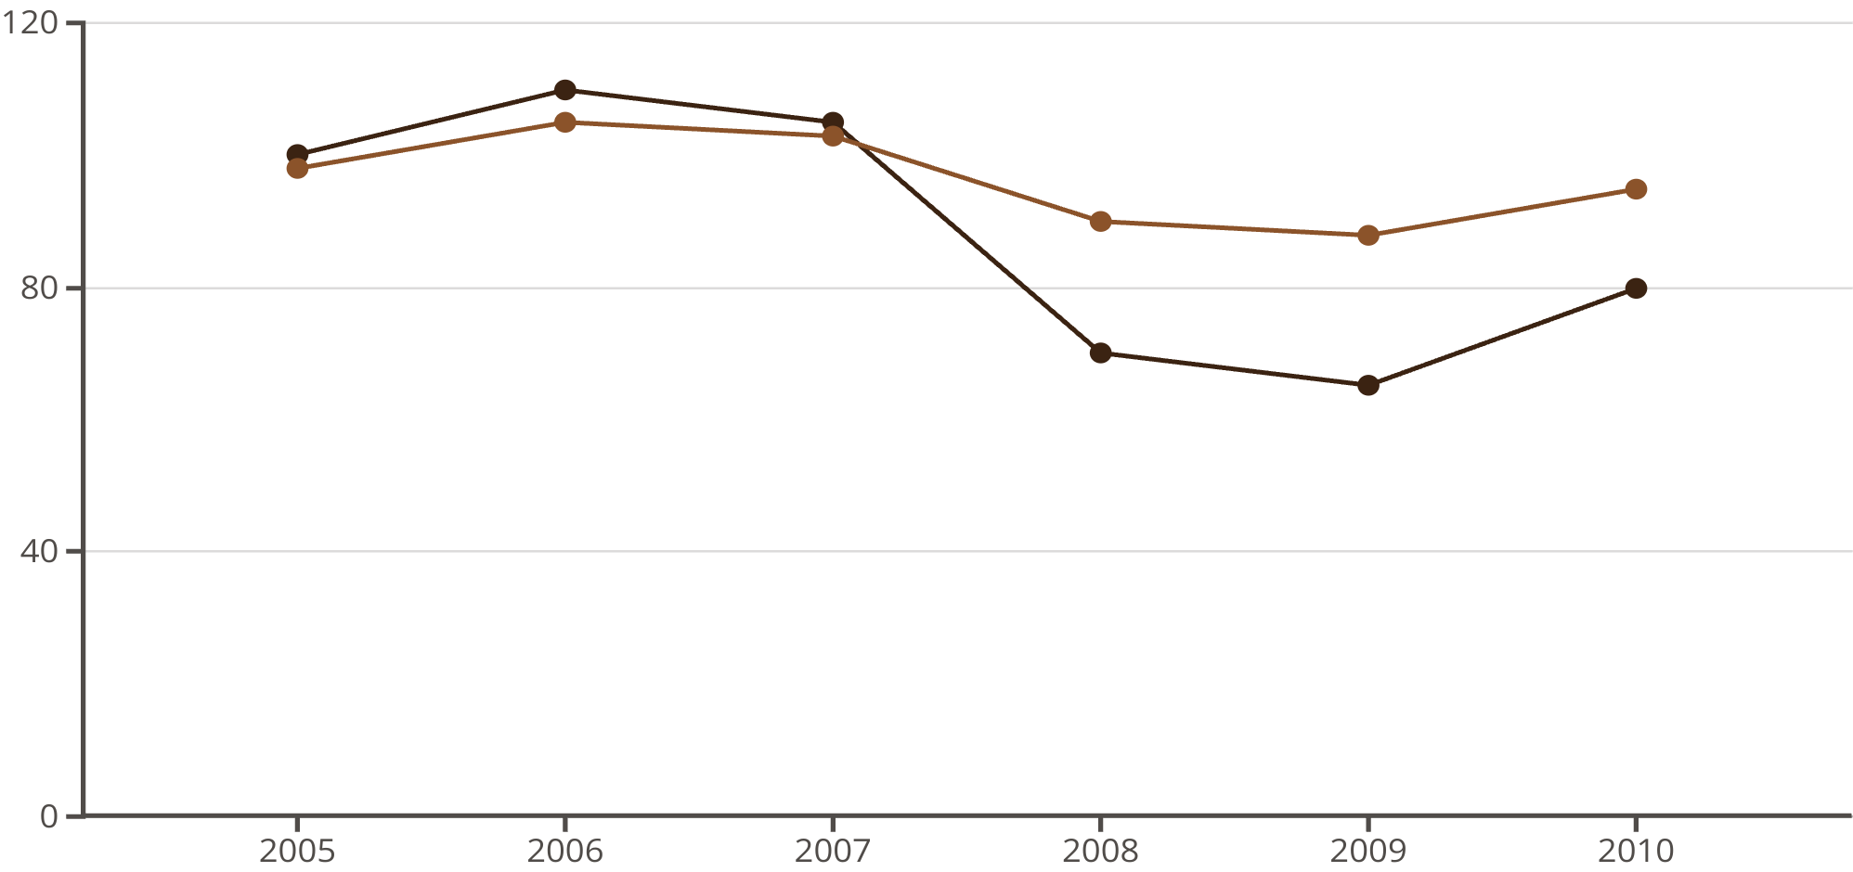

Interactive Dashboard with Plotly Dash
The Plotly Dash dashboard provides real-time, interactive insights. Users can filter data by year and vehicle type using intuitive drop-down menus.
The dashboard dynamically displays sales trends, facilitates GDP comparisons, and breaks down advertising expenditure, empowering data-driven strategic business decisions.
Sales Trend
GDP Comparison

